Slide 1

Presentation on Minor project
Guided By:-
Asst. Prof. Pushpendra Dwivedi
Asst. Prof. Mrs. Arzoo
Group Members:-
Abhishek Baghel(02)
Anchal Nagwanshi(07)
Pratik Kujur (34)

Slide 2
Driver Monitoring System (Using Deep learning)

Slide 3
Content
INTRODUCTION
ABSTRACT
LITREATURE SURVEY
PROPOSED MODEL
ALGORITHM TO BE USED-
FLOW CHAT
DATASET
RESULT
REFERENCES

Slide 4
INTRODUCTION
Drowsiness is the biggest reason for road accidents .
21% of all fatal accidents are due to drowsy driving.
The National Highway Traffic Safety Administration estimated that 100,00 accidents are the direct result of driver fatigue each year.

Slide 5
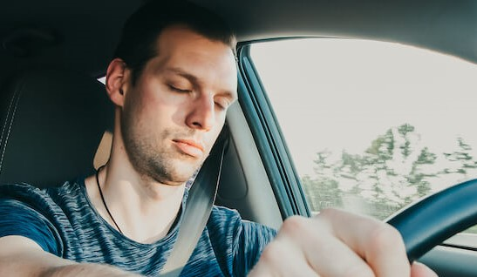
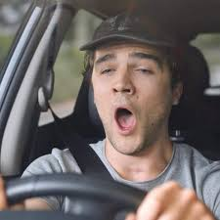
ABSTRACT
This Driver Monitoring System is a Safety alarm system that Alerts the driver whenever he feels drowsy .
In this, The behavior of the driver is monitored live and whenever the driver feels asleep or closes eye for few seconds or yawn. Then it alerts the driver with the help of a loud alarm.

Slide 6
LITREATURE SURVEY
[1] Drowsiness leads to poor performance in driving. People gradually perform more poorly on tasks performed for extended periods of time at night and following loss or disturbance of sleep.
[2]Existing System includes-
Vehicle-Based Measurement
Behavioral Measurement
Physiological Measurement
[3] The EAR is a simple and effective measure for detecting drowsiness, as it only requires a single camera and can be calculated in real-time.
[4] Mouth Aspect Ratio (MAR) is a metric to detect drowsiness or yawning based on the position of lips
[5] Facial landmark detection is a technique to locate the important features from the images.

Slide 7
PROPOSED MODEL
In our model ,we are using deep learning algorithm called CNN for detecting the face.
For constructing this model we are using the LaPa dataset , which consist of more than 22,000 images and 106 facial landmarks .
After training and testing, we are feeding real-time input to our model to predict the facial landmarks .
On the basis of the predicted landmarks we will be calculating EAR and MAR to classify yawning (or not) and eyes closed (or not)

Slide 8
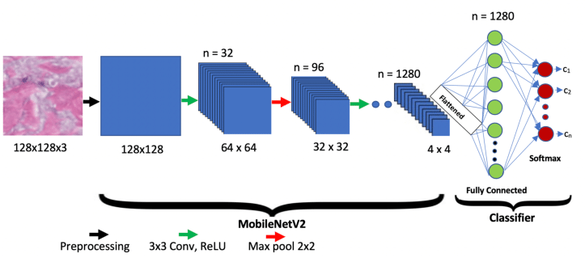
ALGORITHM TO BE USED- CNN(Convolutional Neural Network)
CNN is divide into two parts -1)features extraction(convolutional layer , pooling layer)
2)classification (fully connected layer)

Slide 9
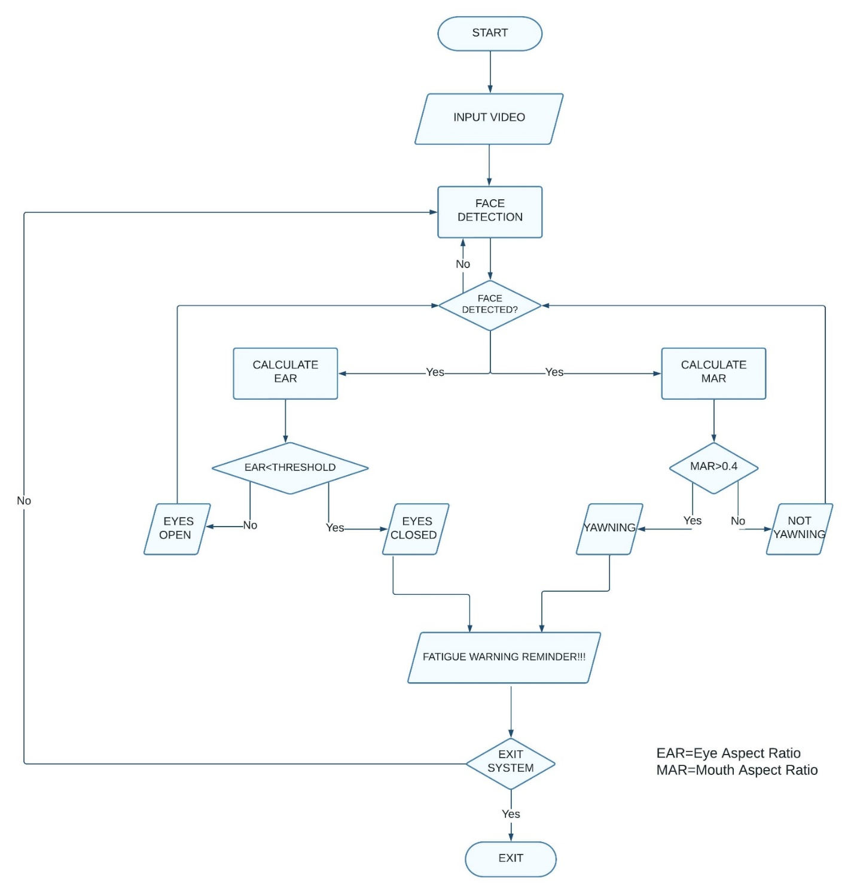

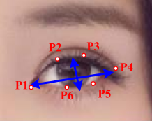
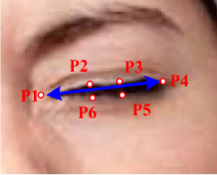
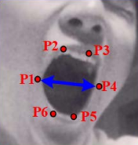
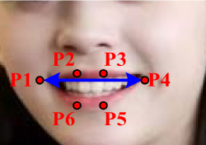
FLOW CHAT

Slide 10
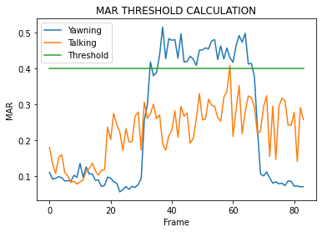

Slide 11
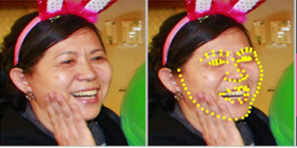
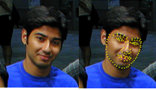
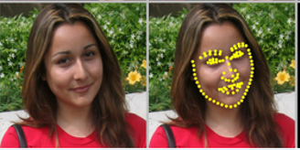
DATASET
Landmark guided face Parsing dataset (LaPa)
22,000+ facial images (.jpg)
106 points landmarks

Slide 12
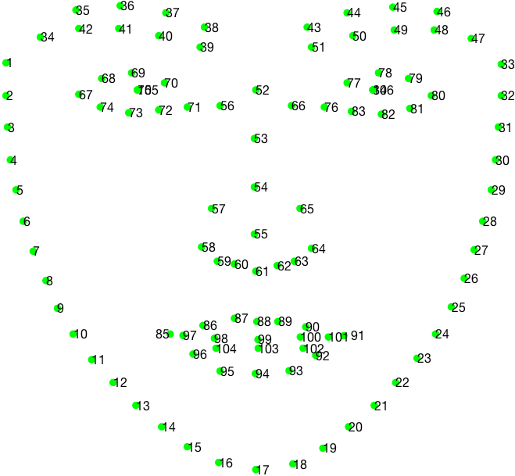
(x1, y1)
Key points = 106
Features = 212

Slide 13
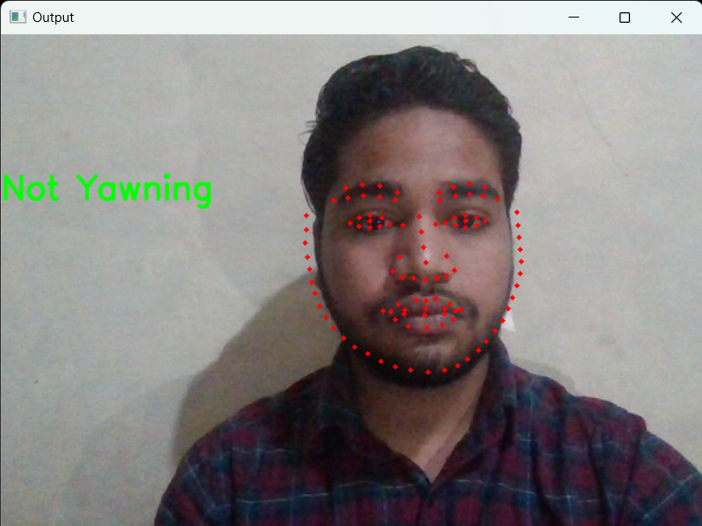
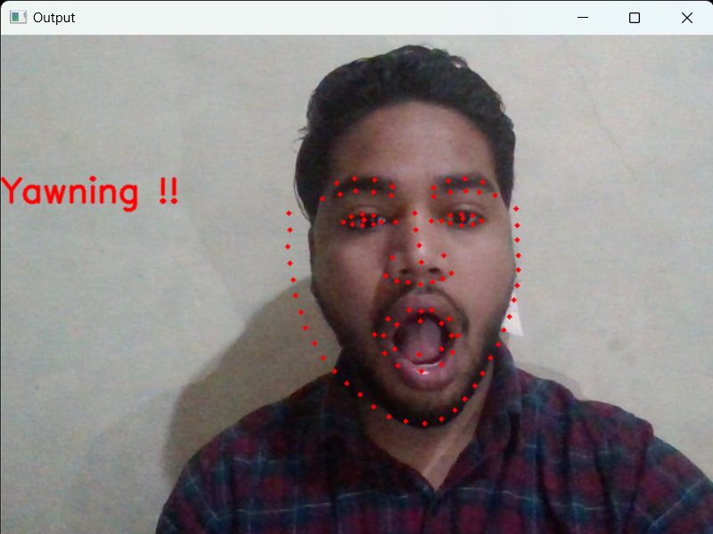
RESULT
Not Yawning
Yawning

Slide 14
References
1.Willem B. Verweya, David M. Zaidelb: “Predicting drowsiness accidents from personal attributes, eye blinks and ongoing driving behavior”, Volume 28, Issue 1, 1 January 2000, Pages 123-142
2.Arun Sahayadhas *, Kenneth Sundaraj and Murugappan Murugappan: “Detecting Driver Drowsiness Based on Sensors: A Review ”, Sensors 2012, 12, 16937-16953; doi:10.3390/s121216937
3.Christine Dewi, Rung-Ching Chen, Chun-Wei Chang, Shin-Hung Wu, Xiaoyi Jiang Hui Yu: “Eye Aspect Ratio for Real-Time Drowsiness Detection to Improve Driver Safety” , Volume 11, Issue 19, 30 September 2022
4.Burcu Kir Savas, Yasar Becerikli: “Real Time Driver Fatigue Detection Based on SVM Algorithm”, 2018 6th International Conference on Control Engineering & Information Technology (CEIT)
5.Yue Wu, Qiang Ji: “Facial Landmark Detection: A Literature Survey”, International Journal on Computer Vision, 2017

